Slide 1
Computer Networks
CSE3101 · Lecture 1 — Introduction & Motivation

Slide 2
Course Contents
Introduction, history, and development of computer networks
Layered architecture — the OSI Model and TCP/IP Model
Application Layer: basic communication applications and protocols
Transport Layer: services, protocols, and reliable protocol design
Network Layer: services, routing algorithms, addressing, sub-networks
Link Layer: channel access, addressing, interconnection devices
Physical Layer: physical media, data communication basics, line encoding
Wireless LAN, IEEE 802.11, 3G/4G, and Wireless Sensor Networks
Reference: Kurose & Ross — Computer Networking: A Top-Down Approach (6e)
Reference: Tanenbaum — Computer Networks (4e) · Forouzan & Mosharraf — Computer Networks: A Top-Down Approach

Slide 3
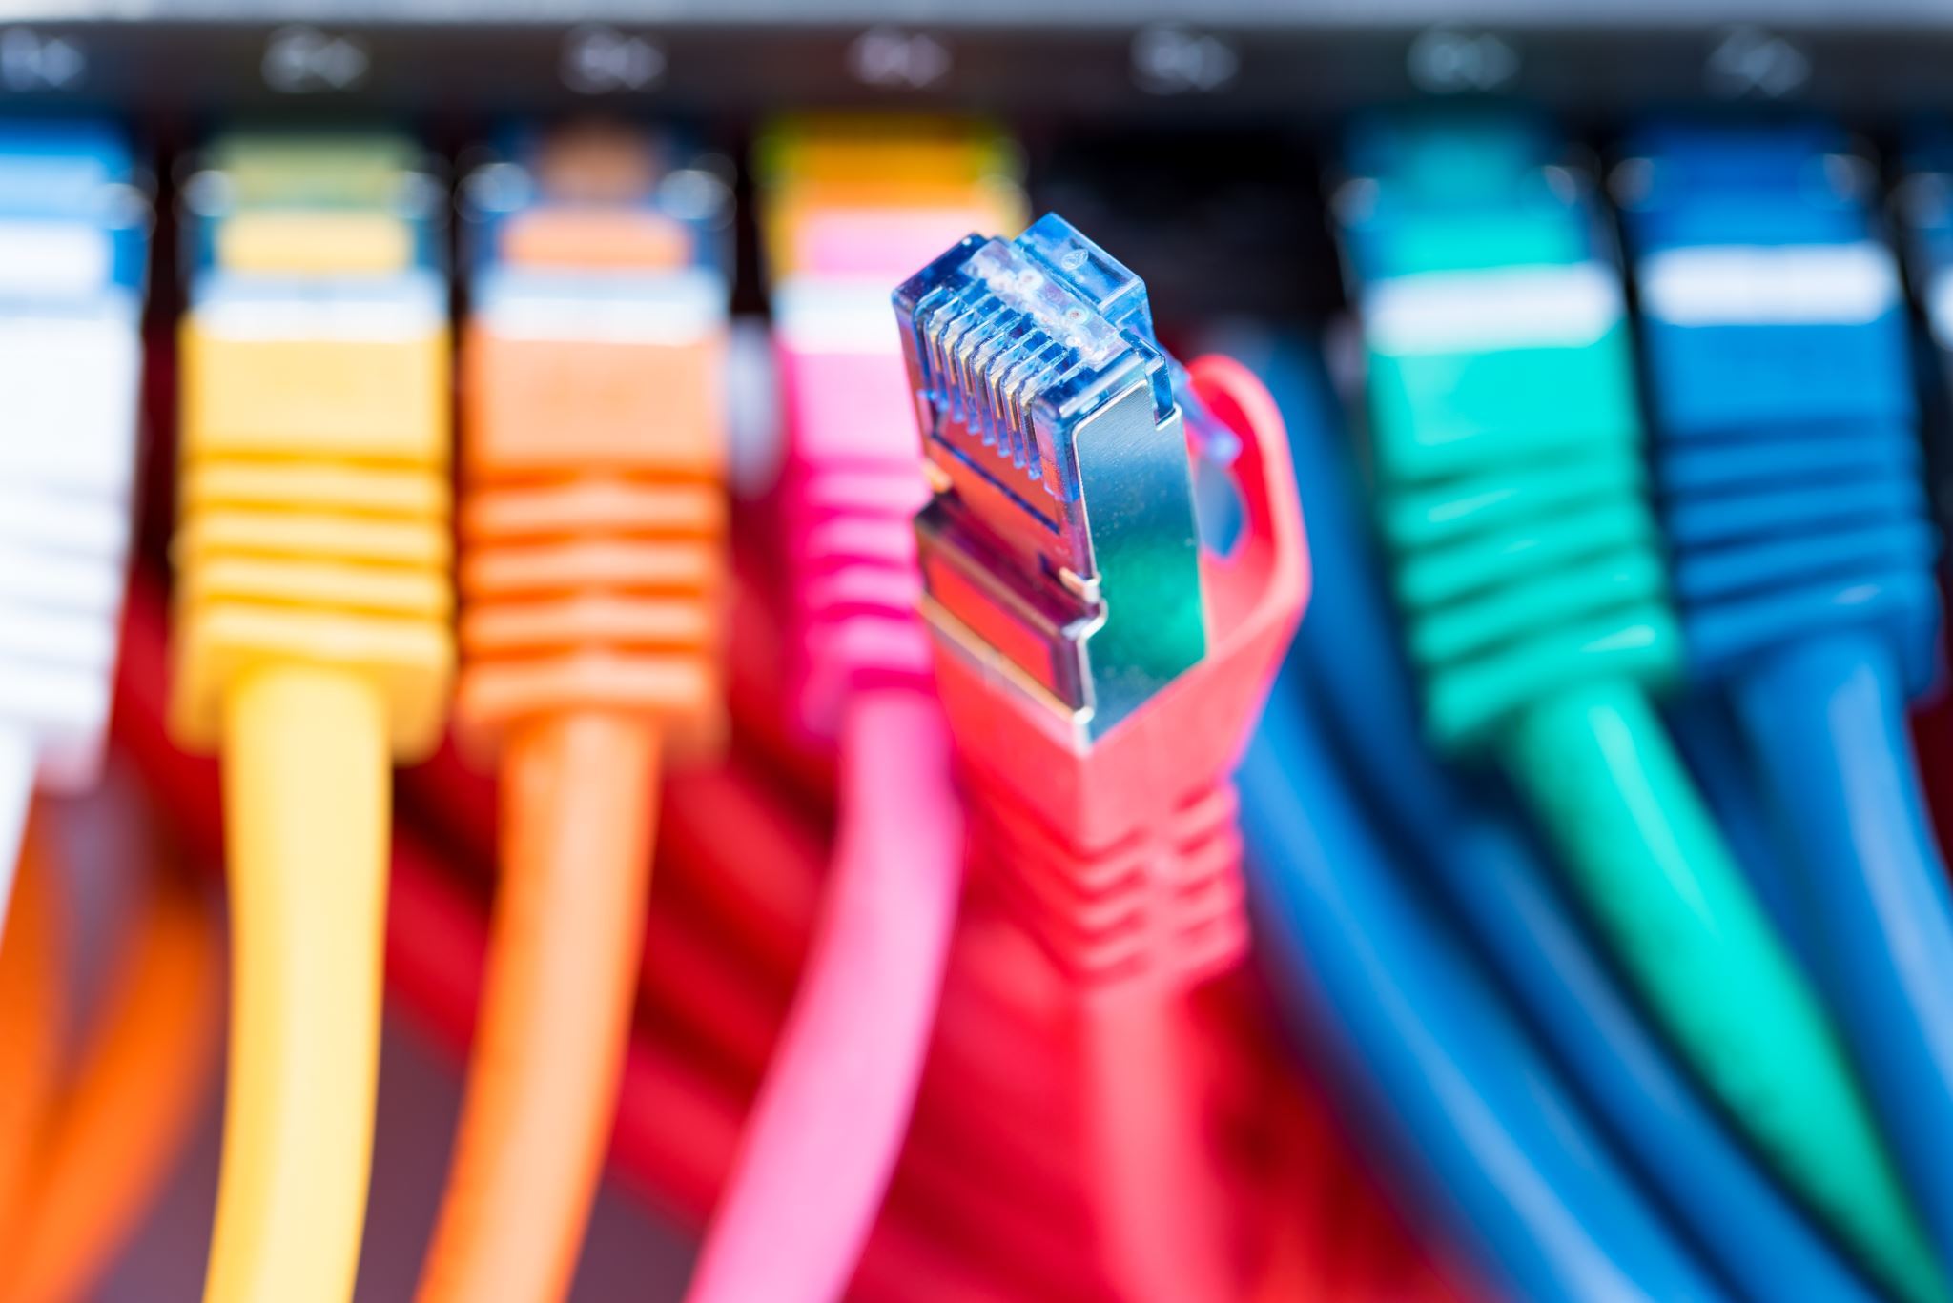
What Is a Computer Network?
A network is a set of devices (often called nodes) connected by communication links.
A node can be a computer, printer, or any other device capable of sending and/or receiving data.
A link can be a cable, air, optical fiber, or any medium that can carry a signal carrying information.

Slide 4
Layers of Identification on a Network
Network — identified using the Network ID (NetId)
Host — identified using the Host ID (HostId)
Process — identified using the Port Number
  Together, NetId + HostId form the device's IP address (e.g. 192.68.42.42)
Application-layer protocols such as DNS, HTTP, and SMTP operate on top of this addressing
  DNS converts a human-readable name into an IP address — this adds a small overhead

Slide 5

Network Criteria
Performance:
  Depends on the network elements involved
  Measured in terms of delay and throughput
Reliability:
  Failure rate of network components
  Measured in terms of availability and robustness
Security:
  Protecting data from corruption or loss due to errors or malicious users

Slide 6
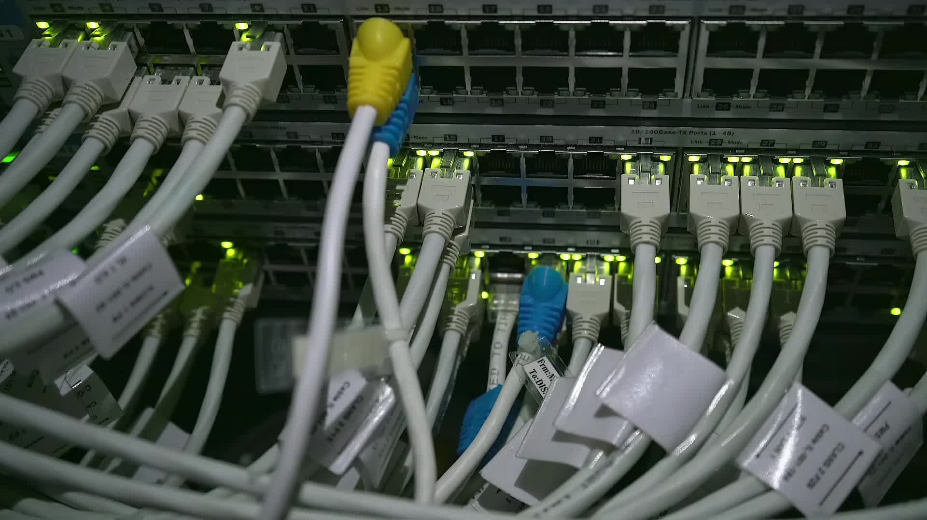
Type of Connection
Point-to-Point:
  A single transmitter and a single receiver
Multipoint:
  Multiple recipients share a single transmission
Physical Topology:
  How devices are physically connected to one another
Type of Transmission:
  Unicast — web browsing, email
  Multicast — online gaming, live webinars
  Broadcast — Wi-Fi setup, telecast

Slide 7

Protocol
A protocol is synonymous with a rule.
It consists of a set of rules that govern data communication.
It determines what is communicated, how it is communicated, and when it is communicated.
The key elements of a protocol are syntax, semantics, and timing.

Slide 8
Elements of a Protocol
Syntax
Structure or format of the data.
Indicates how to read the bits — field delineation.
Semantics
Interprets the meaning of the bits.
Knows which fields define what action.
Timing
When data should be sent, and at what speed —
and when it is expected to be received.

Slide 9
Motivation: The Information Economy
Today's economy is built not just on creating, distributing, and retailing goods —
— but increasingly on creating, distributing, and retailing information itself.
The future economy is likely to be dominated by information.

Slide 10
What Is Information?
Everyday information takes many forms: books, bills, CDs, and more.
It can exist in analog form (atoms) or digital form (bits).
Converting information from atoms to bits lets us use networks to move it — instead of moving physical atoms.
  This conversion is the foundation of modern data communication.

Slide 11
The Challenges
Represent all types of information as bits.
Move those bits:
  In large quantities
  Everywhere
  Cheaply
  Securely
  With guaranteed quality of service

Slide 12
Today's Networks Are Complex
Modern networks already involve many interconnected systems, protocols, and devices.
Tomorrow's networks will be even more complex.
This course's challenge: build a solid foundation for understanding how it all fits together — layer by layer.

Slide 13
Lecture 2
The OSI Model & TCP/IP

Slide 14
The OSI Model — Seven Layers
7 · Application
The OSI (Open Systems Interconnection) model organizes network communication into 7 layers.
Each layer has a specific job, and hands data to the layer above or below it.
Lower layers (1-3) handle physical transmission and routing.
Upper layers (5-7) handle sessions, formatting, and applications.
Layer 4 (Transport) bridges the two — ensuring reliable end-to-end delivery.
6 · Presentation
5 · Session
4 · Transport
3 · Network
2 · Data Link
1 · Physical

Slide 15
Data Flow From Source to Destination
As data moves down the sender's stack, each layer adds its own header (encapsulation).
The data travels across the physical medium to the destination.
As it moves up the receiver's stack, each layer reads and removes its corresponding header (decapsulation).
Peer layers on the sender and receiver logically communicate as if directly connected — this is the layered communication model.
Layer-to-layer headers are added at every hop: 7th, 6th, 5th... down to 1st header, then physical transmission of bits.

Slide 16
TCP/IP Model
The layers in the TCP/IP protocol suite do not exactly match those of the OSI model.
The original TCP/IP suite defined four layers:
  Host-to-Network, Internet, Transport, and Application
Compared against OSI, TCP/IP is often described using five layers:
  Physical, Data Link, Network, Transport, and Application
In practice, TCP/IP merges OSI's top three layers (Session, Presentation, Application) into a single Application layer.

Slide 17
Overview: OSI vs. TCP/IP
OSI Model (7 layers)
TCP/IP Model (4-5 layers)
Application
Presentation
Session
Transport
Network
Data Link
Physical
Application (merges App/Presentation/Session)
Transport
Network (Internet)
Data Link
Physical

Slide 18
Addressing in TCP/IP
Four levels of addresses are used across the TCP/IP protocol stack:
Physical
Hardware/MAC address at the Data Link layer.
Logical
IP address identifying the host on the network.
Port
Identifies the specific process/application.
Specific
Application-level identifier (e.g. email address).

Slide 19
Lecture 3
Networking Fundamentals & Topologies

Slide 20
Early Communication Systems & Data Networks
A data network is a set of interconnected nodes that exchange information.
Sharing of transmission circuits among many users is called switching.
Multiple links between nodes allow more than one path between any two nodes.
The network must select an appropriate path for each required connection.

Slide 21
Networking Issues: Telephone vs. Internet
Telephone Network
Internet
Addressing: phone number = country code + city code + exchange + number
Routing: circuit switching, based on the phone number
Information units: fixed-rate samples — not self-descriptive
Addressing: IP address = network number + host number
Routing: packet switching — chunks routed independently
Information units: self-descriptive packets (data + header)

Slide 22
Categories of Networks: LAN, MAN & WAN
LAN (Local Area Network):
  A network within a small geographical area — a room, building, or campus.
MAN (Metropolitan Area Network):
  A network spanning a city.
WAN (Wide Area Network):
  A network spread across a country or the globe — e.g. the World Wide Web.

Slide 23
Applications of Networks
Resource Sharing:
  Hardware (computing resources, disks, printers)
  Software (application software)
Information Sharing:
  Easy accessibility from anywhere (files, databases)
  Search capability (WWW)
Communication:
  Email, message broadcast, remote and distributed computing (e.g. GRID computing)

Slide 24
Network Topology
Network topology defines the way computers, printers, and other devices are connected.
It describes the physical layout of wiring and devices, as well as the paths data can take.
Common topologies: Bus, Star, Tree, Ring, and Mesh — each covered next.

Slide 25
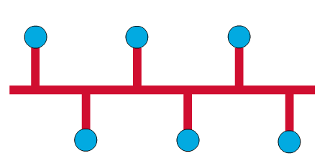
Bus Topology
Commonly referred to as a linear bus.
All devices on a bus topology are connected by a single shared cable.
Simple and cheap, but a single cable fault can disrupt the whole network.

Slide 26
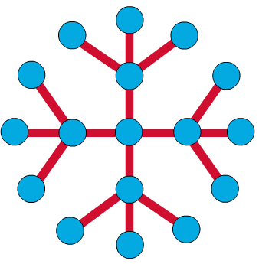
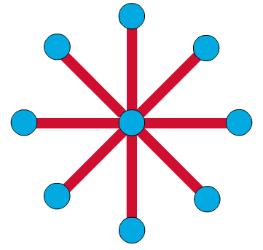
Star & Tree Topology
Star: the most common architecture in Ethernet LANs — resembles spokes on a bicycle wheel.
Tree (extended star): larger networks link multiple stars together via bridges, switches, or routers.
This significantly reduces traffic by filtering frames/packets at each intermediate device.

Slide 27
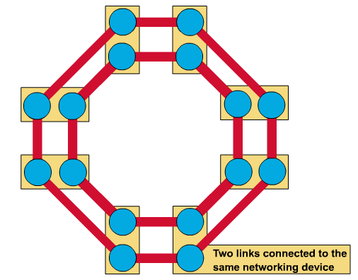
Ring Topology
A frame travels around the ring, stopping at each node.
A transmitting node adds its data plus the destination address to the frame.
The frame circulates until it reaches the destination node, which extracts the data.
Single ring: all devices share one cable. Dual ring: allows data to travel in both directions for redundancy.

Slide 28
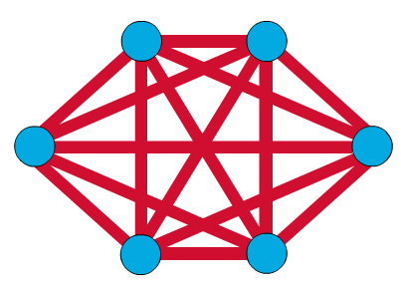
Mesh Topology
Connects every device (node) to every other device — for redundancy and fault tolerance.
Used in WANs to interconnect LANs, and for mission-critical networks (e.g. banks, financial institutions).
Implementing a full mesh is expensive and difficult to scale.

Slide 29
Lecture 4
Transmission Media

Slide 30
Transmission Media & the Physical Layer
Transmission media are the physical pathways that carry signals between devices.
They sit below and are directed by the physical layer of the network stack.
Two broad classes of transmission media:
  Guided media — twisted-pair, coaxial, and fiber-optic cable
  Unguided media (wireless) — radio waves, microwaves, and infrared

Slide 31
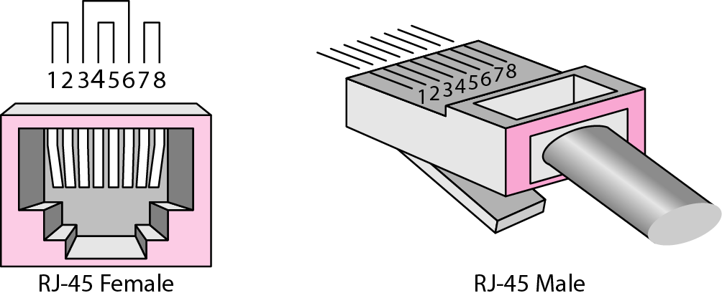
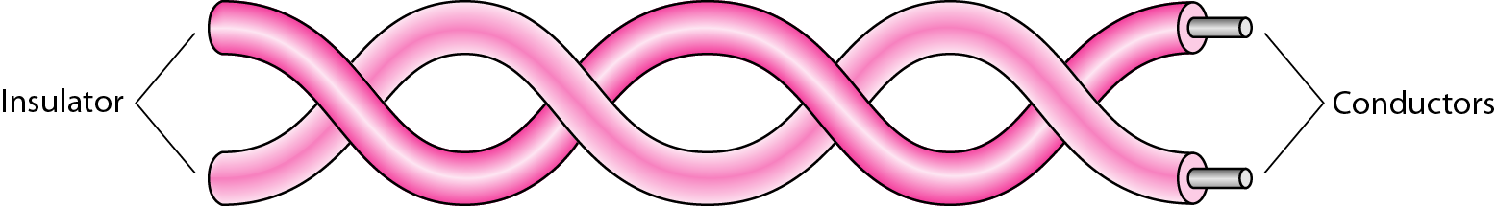
Guided Media: Twisted-Pair Cable
Two insulated copper wires twisted together to reduce electromagnetic interference.
UTP (Unshielded) vs. STP (Shielded Twisted Pair) — STP adds a metal foil for extra noise protection.
UTP cables are graded into categories (e.g. Cat 5e, Cat 6) — higher categories support higher data rates.
Terminated using RJ-45 connectors; performance depends on category, length, and installation quality.

Slide 32
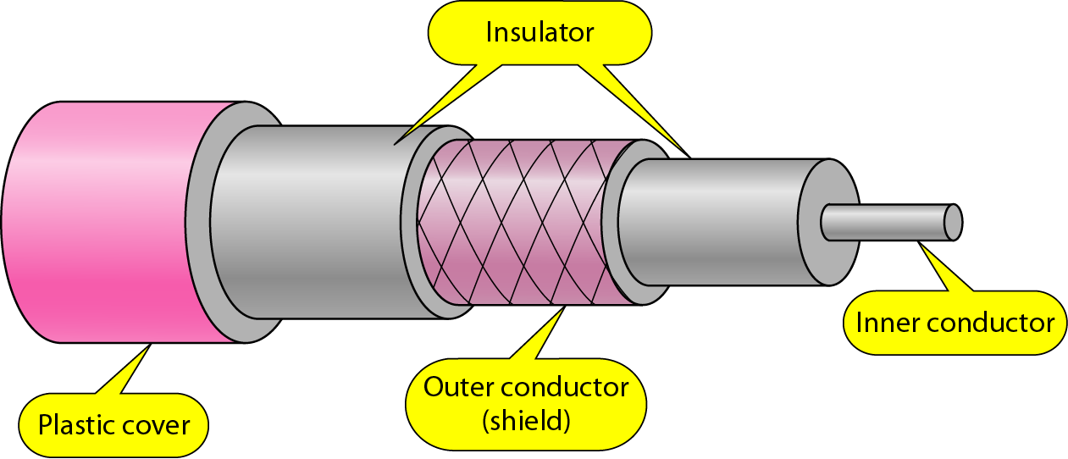
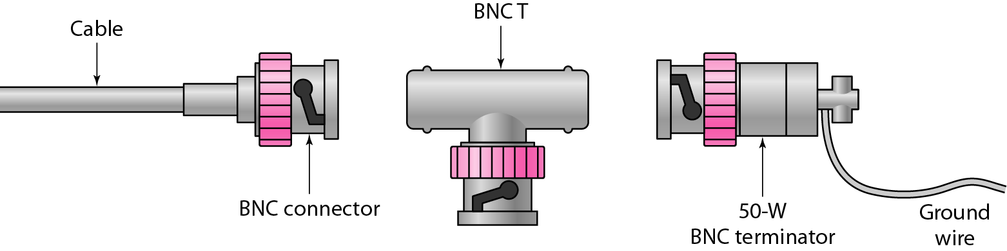
Guided Media: Coaxial Cable
A single copper core conductor, surrounded by insulation, a metallic shield, and an outer jacket.
The shielding gives coaxial cable much better noise immunity than twisted pair.
Categorized (e.g. RG-59, RG-6) by impedance and application (cable TV, baseband networking).
Terminated using BNC connectors — supports higher bandwidth over longer distances than UTP.

Slide 33
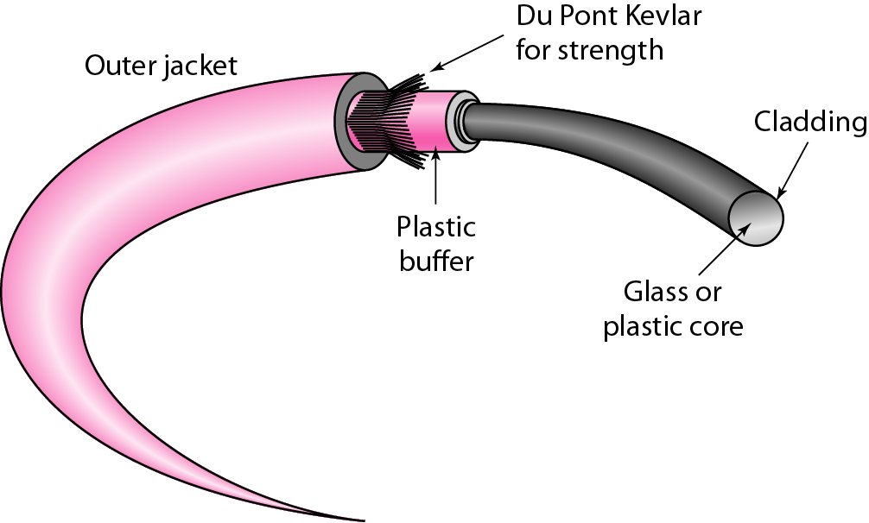
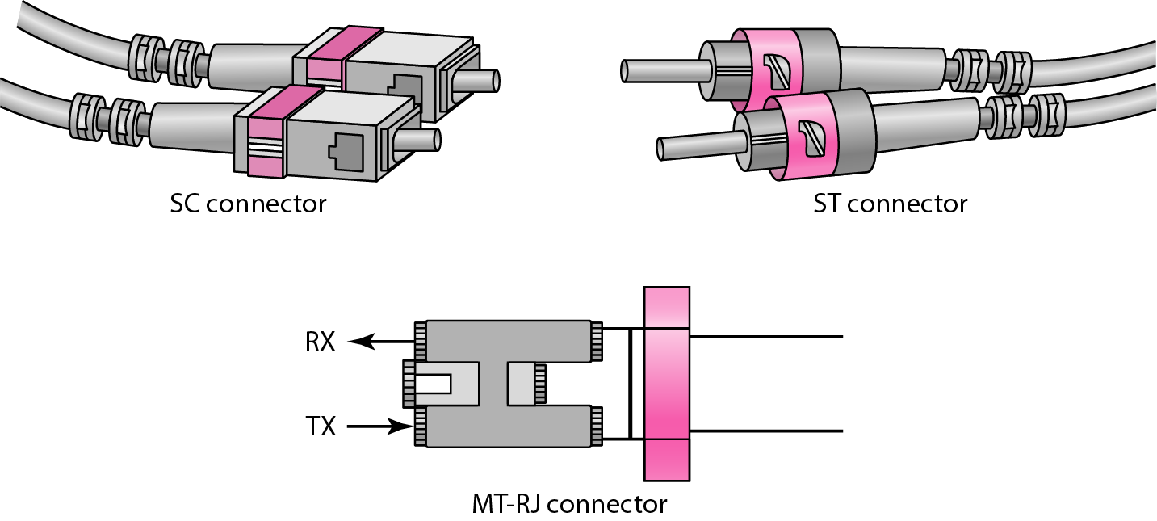
Guided Media: Fiber-Optic Cable
Transmits data as pulses of light through a thin glass or plastic fiber.
Light stays within the core through total internal reflection — the light ray bends and travels along the fiber.
Construction: a core, surrounded by cladding, a buffer, and an outer jacket.
Offers very high bandwidth, long distance, and strong immunity to electromagnetic interference.
Uses connectors such as SC and ST for termination.

Slide 34
Unguided Media: Wireless Communication
Unguided media transport electromagnetic waves without a physical conductor.
This is generally referred to as wireless communication.
Three main types, based on frequency band:
  Radio Waves — omnidirectional, penetrate walls, used for broadcast
  Microwaves — directional, line-of-sight, used for point-to-point links
  Infrared — very short range, line-of-sight only, blocked by walls

Slide 35
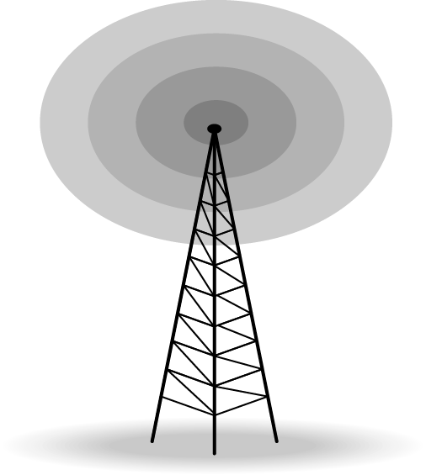
Radio Waves
Used for multicast communication, such as radio, television, and paging systems.
Can penetrate through walls.
Highly regulated by governments/spectrum authorities.
Typically use omnidirectional antennas — signal radiates equally in all directions.

Slide 36
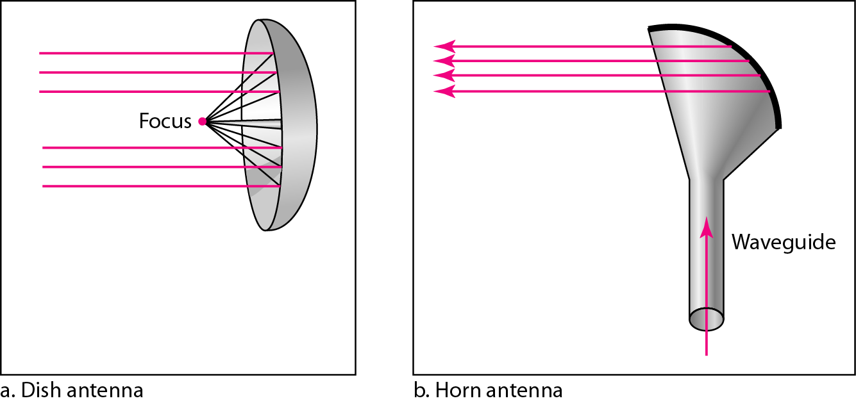
Microwaves
Used for unicast communication — cellular telephones, satellite networks, and wireless LANs.
Higher frequency ranges cannot penetrate walls.
Use directional (unidirectional) antennas for focused, point-to-point line-of-sight communication.

Slide 37
Infrared & Wireless Channel Challenges
Infrared:
  Used for short-range communication within a closed area, using line-of-sight propagation.
Wireless channels in general:
  Subject to far more errors than guided media.
  Interference is a major cause of errors — mitigated with a higher signal-to-noise ratio (SNR).
  Higher SNR reduces available capacity, due to the broadcast nature of the channel.
  Channels are also subject to fading and coverage holes.

Slide 38
Lecture 5
Wireless Networks & Mobile Ad Hoc Routing

Slide 39
Wireless Networks: Three Approaches
The need: access to computing and communication services while on the move.
Infrastructure-based Networks:
  Traditional cellular systems, relying on base-station infrastructure
Wireless LANs:
  Infrared (IrDA) or radio links (e.g. WaveLAN); flexible within a reception area, ad-hoc capable
  Lower bandwidth than wired networks (roughly 1-10 Mbit/s)
Ad Hoc Networks:
  Useful when fixed infrastructure is unavailable, impractical, or too costly

Slide 40
Cellular Wireless Networks
Provides single-hop wireless connectivity to the wired network.
Coverage space is divided into cells.
A base station communicates with all hosts within its cell.
Mobile hosts can change cells while communicating.
"Hand-off" occurs when a mobile host starts communicating via a new base station.

Slide 41
Multi-Hop Wireless & MANETs
Multi-Hop Wireless:
  A packet may need to traverse multiple links to reach its destination.
  Mobility causes routes to change over time.
Mobile Ad Hoc Networks (MANET):
  Host movement and topology changes are frequent.
  No cellular infrastructure — purely multi-hop wireless links.
  Data must be routed via intermediate nodes.

Slide 42
Why Ad Hoc Networks?
Setting up fixed access points and backbone infrastructure is not always viable:
  May not be present in a disaster area or war zone
  May be impractical for very short-range radios, e.g. Bluetooth (~10 m range)
Advantages of ad hoc networks:
  Do not need backbone infrastructure support
  Easy to deploy quickly
  Useful when infrastructure is absent, destroyed, or impractical

Slide 43
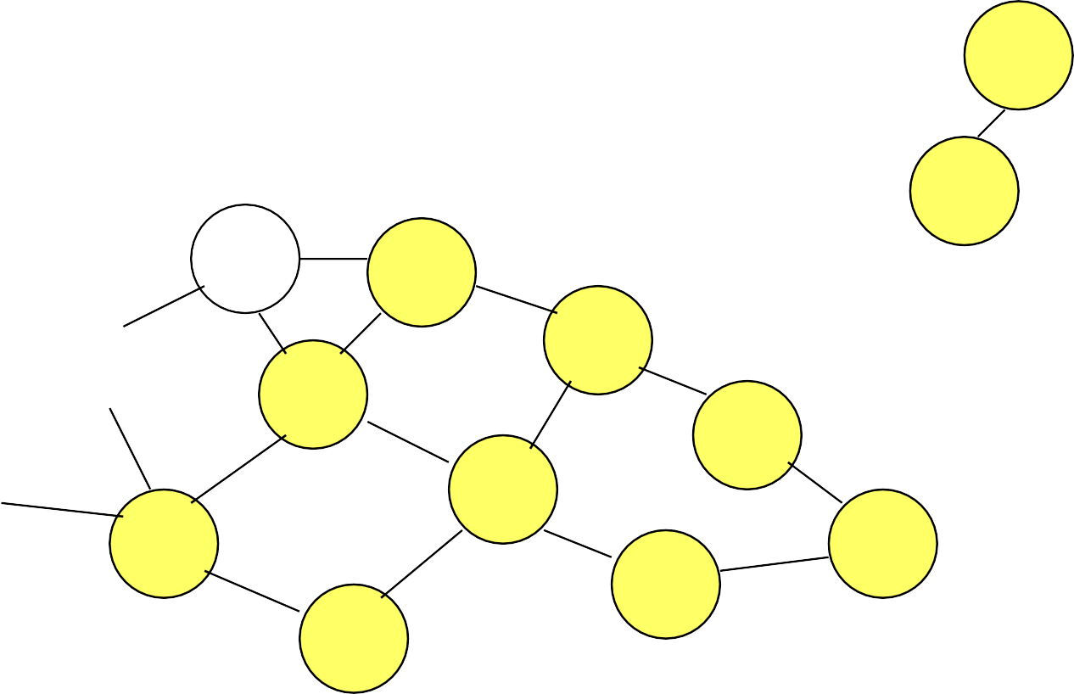
Dynamic Source Routing (DSR): Route Discovery
When node S wants to reach node D but has no known route, it initiates route discovery.
1. Source node S floods a Route Request (RREQ) to its neighbors.
2. Each node appends its own identifier and re-broadcasts the RREQ.
3. A node that has already forwarded an RREQ once will not forward it again — this prevents loops.
4. When the RREQ reaches destination D, D does not forward it further.

Slide 44
DSR: Route Reply & Data Delivery
On receiving the first RREQ, destination D sends a Route Reply (RREP).
The RREP is sent back along the reverse of the route recorded in the RREQ.
It carries the full source-to-destination route discovered during the search.
Node S caches this route on receiving the RREP.
Data packets from S to D now carry the entire route in their header — hence "source routing".
  Note: packet header size grows with route length.

Slide 45
Applications & Challenges of Ad Hoc Networks
Many Applications
Key Challenges
Personal area networking (phone, laptop, earphone, watch)
Military environments (soldiers, tanks, planes)
Civilian use (taxi networks, meeting rooms, stadiums)
Emergency operations (search-and-rescue, firefighting)
Wireless limits: packet loss, variable capacity, disconnections
Mobility: dynamically changing topologies and routes
Device limits: short battery life, limited processing power
Lack of mobility awareness in system/applications

Slide 46
Lecture 6
Switching Techniques

Slide 47
Switching Networks
Long-distance transmission is typically carried over a network of switched nodes.
Nodes are not concerned with the content of the data — they simply forward it.
End devices (computers, terminals, phones) are called stations.
Data is routed by being switched from node to node across the network.
Two fundamental switching technologies: Circuit Switching and Packet Switching.

Slide 48
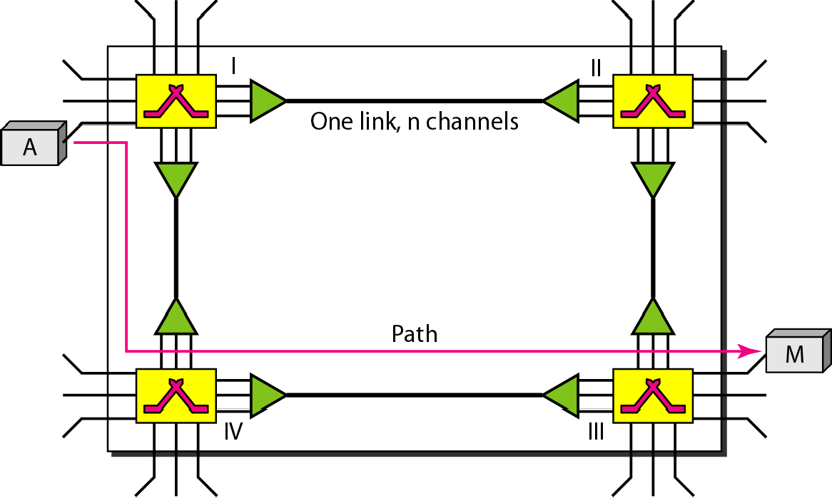
Circuit Switching: Concept & Phases
A circuit-switched network is a set of switches connected by physical links.
A connection between two stations is a dedicated path of one or more links.
Each link is typically divided into n channels, using FDM or TDM.
Three phases of a circuit-switched call:
  1. Establish — set up the dedicated path
  2. Transfer — data flows along the reserved path
  3. Disconnect — the circuit is torn down

Slide 49
Circuit Switching: Applications & Components
Resources are reserved for the whole call — if there's no data, capacity is wasted (inefficient).
Setting up the connection takes time; once connected, transfer is fully transparent.
Originally developed for voice traffic (telephone networks).
Key telecom components:
  Subscriber — device attached to the network, via a local loop (few km to tens of km)
  Exchange — switching center; the "end office" supports subscribers directly
  Trunks — multiplexed links between exchanges

Slide 50
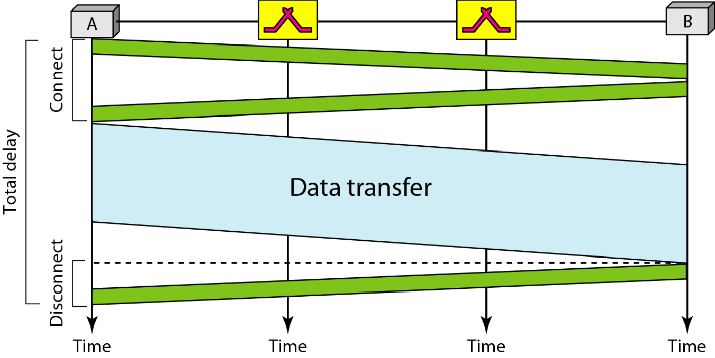
Circuit Switching: Delay
Resources are reserved during setup and remain dedicated through the entire data transfer, until teardown.
Total delay includes: connection setup time, data transfer time, and disconnect time.
Because the path is fixed, once established, delay is very predictable — ideal for real-time voice traffic.
The traditional telephone network uses circuit switching at the physical layer.

Slide 51
Packet Switching: Principles
Circuit switching was designed for voice — resources are dedicated to a call, even when idle.
Packet switching addresses this inefficiency: there is no resource reservation.
Resources are instead allocated on demand.
Basic operation:
  Data is transmitted in small packets (typically ~1000 octets).
  Longer messages are split into a series of packets.
  Each packet carries user data plus control/routing information.
  Packets are received, briefly buffered, and forwarded — "store and forward".

Slide 52
Packet Switching: Advantages
Line efficiency: a single node-to-node link can be shared by many packets over time.
Data rate conversion: each station connects to its local node at its own speed; nodes buffer as needed.
Packets are accepted even when the network is busy (delivery may simply slow down).
Priorities can be assigned to different packets.
Two ways packets can be handled: Datagram or Virtual Circuit — covered next.

Slide 53
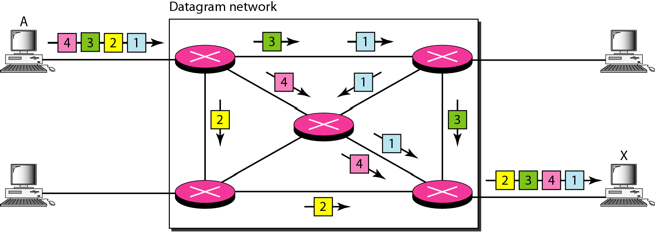
Datagram Networks
Each packet (datagram) is treated completely independently.
Packets can take any practical route to the destination.
As a result, packets may arrive out of order, or go missing entirely.
It's up to the receiver to re-order packets and recover from any losses.
A switch (router) uses a routing table based on the destination address in each packet's header — this address stays the same for the packet's entire journey.
  The Internet uses the datagram approach for switching.

Slide 54
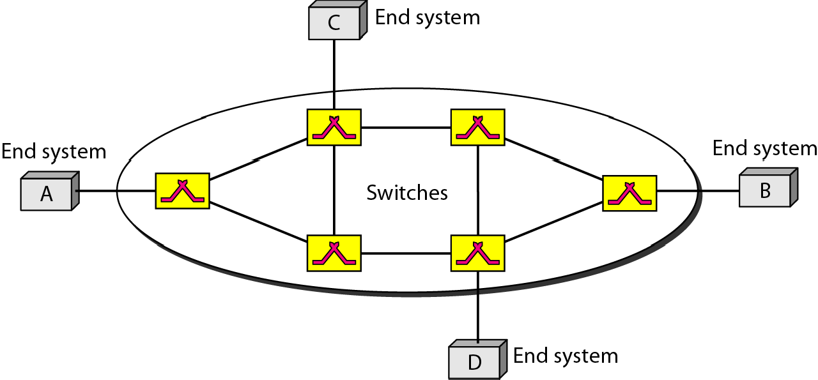
Virtual-Circuit Networks
A hybrid — combines characteristics of circuit switching and datagram networks.
A route is pre-planned and established before any packets are sent.
Call-request / call-accept packets perform a handshake to establish the connection.
Each packet carries a virtual-circuit identifier, instead of a full destination address.
No per-packet routing decisions are required once the circuit is set up.
All packets travel the same path, but may still arrive with different delays if resources are allocated on demand.

Slide 55
Virtual Circuits vs. Datagram
Virtual Circuits
Datagram
Network can provide sequencing and error control
Packets are forwarded more quickly (no per-packet routing)
Less reliable — losing a node loses every circuit through it
No call-setup phase — better for short bursts of traffic
More flexible: routing can avoid congested parts of the network
Each packet routed independently

Slide 56
Circuit vs. Packet Switching: Performance
Total delay in a switched network is made up of three components:
Propagation delay:
  Time for a signal to physically travel across the link
Transmission time:
  Time needed to push all of a message's bits onto the link
Node delay:
  Processing/queuing time at each intermediate switch or router
Circuit switching front-loads delay at setup; packet switching distributes delay across each hop.

Slide 57
Message Switching
A connectionless technique where the entire message is routed from source to destination, one hop at a time.
It was a precursor to packet switching.
The sender adds the destination address to the whole message before sending.
Each intermediate node stores the full message, checks for transmission errors, inspects the destination address, and forwards it — "store and forward" at the message level.
If the required outgoing circuit is busy, the message is queued rather than discarded.

Slide 58
Crossbar Switch
The simplest type of switching fabric.
A crossbar switch connects n inputs to n outputs in a grid.
Electronic microswitches sit at each crosspoint of the grid, connecting a given input to a given output on demand.

Slide 59
Lecture 1–6: Key Takeaways
Networks are built on layered architectures — the OSI and TCP/IP models — so each layer can evolve independently.
Data is organized by topology (bus, star, ring, mesh) and carried over guided media (copper, fiber) or unguided media (radio, microwave, infrared).
Wireless and ad hoc networks extend connectivity where fixed infrastructure isn't available, using protocols like DSR for route discovery.
Switching — circuit, packet (datagram/virtual-circuit), and message switching — determines how data actually moves node to node across the network.

